Slide 1

CoreAssess.AI
Proposal
September 2025

Slide 2
1.
Introduction to CoreAssess.AI
2.
Assessment Findings
Agenda
3.
Project Approach
4.
Benefits
5.
Project Commercials
3.
8.

Slide 3


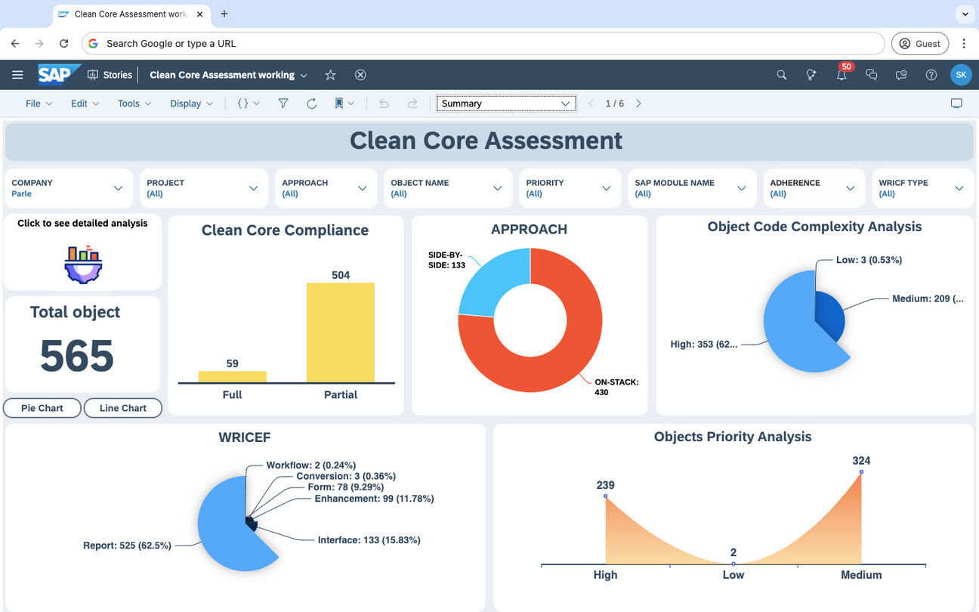
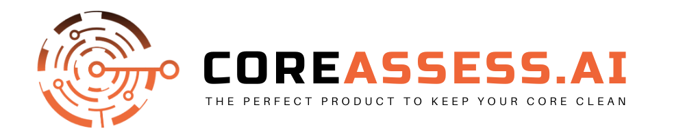

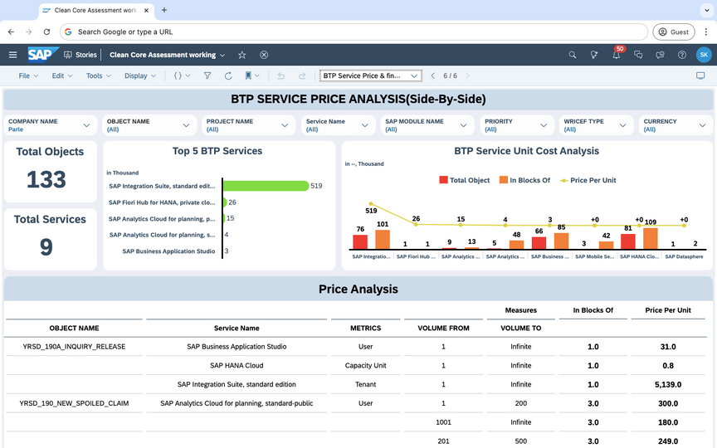

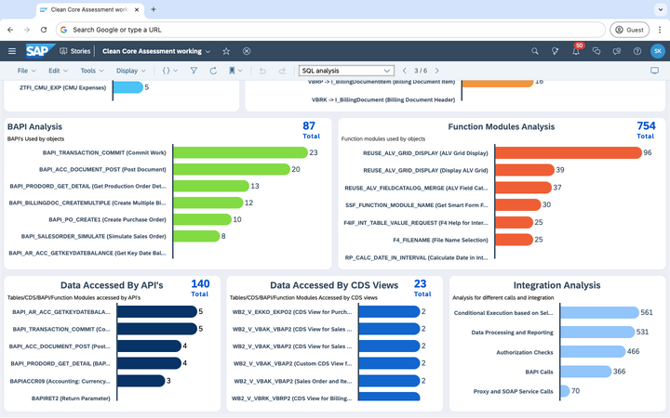
1. CoreAssess.AI is our AI-powered solution to help you keep the core clean
CoreAssess.AI enables you to perform rapid assessment of custom ABAP code leading to reduced technical debt
Key Benefits:
Faster Analysis and Decision-Making: Reduces analysis time from weeks to minutes, enabling quicker project execution and transformation planning.
Holistic Insights: Combines technical and functional perspectives, unlike traditional tools.
Proactive Recommendations: Aligns with SAP’s clean core strategy for long-term success.
Improved Modernization Planning: Provides clear, actionable recommendations for on-stack and side-by-side approaches, supported by accurate BPT service estimations.
08

Slide 4
Features of CoreAssess.AI
Side-By-Side Extensibility Approach
SQL Analysis
BTP Service Estimation: Provides detailed recommendations of required SAP BTP services and events including quantity & cost estimate. Helps customers efficiently plan for event and API-based architecture.
Reports by Use Case: Aligns objects with specific side-by-side use cases including-integration, automation, build, advance event mesh, data & analytics, making it easier to identify and prioritize extension opportunities.
Integration Priority: Highlights objects requiring integration with external applications via BTP capabilities like APIs or event-driven architecture.
Object Code Complexity Analysis: categorizes the complexity of object code into High, Medium, and Low.
UI and Third-Party Integration: highlight the extent of integration with user interfaces and external systems.
Standard Tables Analysis: This section analyzes standard tables frequently used by the objects.
S/4HANA Tables / CDS Views Recommendations: This section lists recommended S/4HANA tables and CDS views, mapping legacy tables to their optimized counterparts in S/4HANA.
BAPI Analysis: This section lists commonly used BAPIs.
On-Stack Extensibility Approach
ROI Calculation
High-Level Recommendations: Provides actionable insights for remediation, optimization, and modernization within the on-stack environment.
Modernization Efforts Estimation: Tool will provide instantaneous estimation for the code modernization with detailed break-down for each object.
AI-Powered ROI Calculation – Automates and simplifies ROI assessment using customer inputs and predefined logic.
Data-Driven Insights – Provides accurate ROI projections to support strategic decision-making.
Optimized Investment Planning – Helps businesses maximize profitability and efficiency.
User-Friendly & Efficient – Delivers quick and reliable financial evaluations.
Enhances Decision-Making – Empowers businesses with actionable insights for smarter investments.

Slide 5

CoreAssess.AI
Assessment
Findings and Recommendations

Slide 6
2. CoreAssess.AI - Assessment Findings
Crave Infotech has concluded the complementary assessment on 3 object provided by Oatey Co.
Listed below is the recommendations summary:
Sr No. | Object Name | Issues | Recommended Approach
1 | ZOTCR_DEL_MULTI_TRAILERS | The program uses custom function modules (e.g., ZSHP_VL10_CREATE_SLS) and direct access to standard tables (VBFA, VBAP, VBEP, MARA, MARM). This violates Clean Core and increases technical debt, creating upgrade risks. | On-Stack
2 | ZOTC_ASN_PROXY_TRIG | The program uses extensive custom code, custom tables (e.g., ZTCA_TRAD_PARTNR), and direct access to SAP standard tables (LIKP, LIPS, VEKP, VEPO, VBAP, VBKD, KNVV, MARM). This creates dependency on core objects, complicates upgrades, and increases technical debt. Integration is managed via custom proxy logic instead of standard APIs, reducing maintainability. | Side-by-Side
3 | zitd_cycle_count_accuracy (Cycle Count) | Custom ABAP report (zitd_cycle_count_accuracy) directly accesses tables (/SCWM/TAAREA, /LIME/PI_LOGHEAD, /LIME/PI_DCTYTXT), uses procedural ABAP, and ALV reporting. This creates upgrade challenges, technical debt, and partial misalignment with SAP’s Clean Core strategy. | Retire

Slide 7
CoreAssess.AI
Assessment
Recommendations for On-Stack Extensibility

Slide 8
Key Insights and Recommendations | On-Stack
Object: ZOTCR_DEL_MULTI_TRAILERS (Bill of Materials Report)
Recommended Approach: On-Stack Extensibility
Key Issues:
The program uses custom function modules (e.g., ZSHP_VL10_CREATE_SLS) and direct access to standard tables (VBFA, VBAP, VBEP, MARA, MARM).
This violates Clean Core and increases technical debt, creating upgrade risks.
Key Modernization Steps:
Replace direct table access with CDS views (I_SalesOrder, I_SalesOrderItem, I_Product, etc.)
Replace custom FMs with standard APIs (API_SALES_ORDER_SRV (Sales Order API), API_MATERIAL_DOCUMENT_SRV (Material Document API)) where possible
Refactor procedural ABAP into OO-ABAP for modularity
Optimize with modern ABAP syntax and AMDP for heavy calculations
Replace ALV/screen 9901 with standard or custom Fiori apps for delivery management

Slide 9
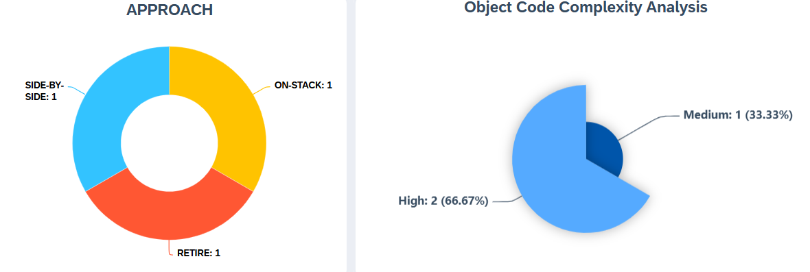
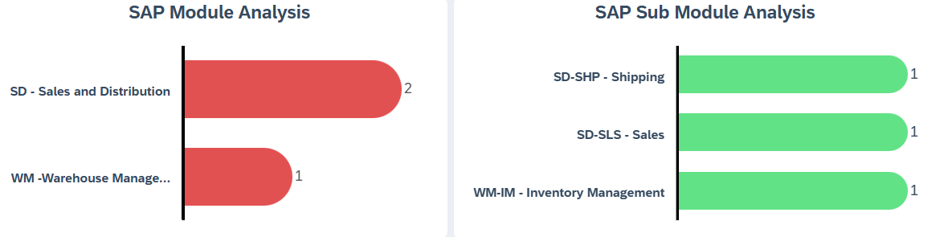
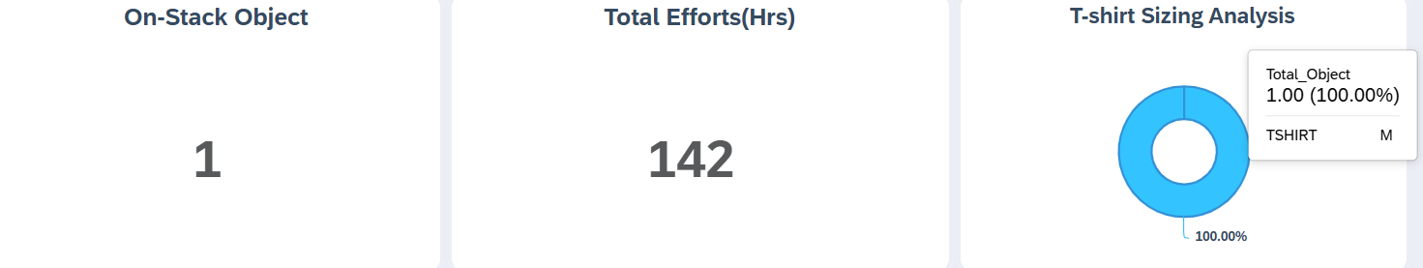
Key Insights and Recommendations | On-Stack
1/3 Objects is a candidate for S/4 HANA On-Stack Extensibility, with an effort estimation of 142 Hours for re-implementation.

Slide 10
CoreAssess.AI
Assessment
Recommendations for Side-By-Side Extensibility

Slide 11
Key Insights and Recommendations | Side-By-Side
Object: ZOTC_ASN_PROXY_TRIG
Recommended Approach: Side-by-Side Extensibility
Key Issues: The program uses extensive custom code, custom tables (e.g., ZTCA_TRAD_PARTNR), and direct access to SAP standard tables (LIKP, LIPS, VEKP, VEPO, VBAP, VBKD, KNVV, MARM). This creates dependency on core objects, complicates upgrades, and increases technical debt. Integration is managed via custom proxy logic instead of standard APIs, reducing maintainability.
Key Modernization Steps:
Replace direct table access with CDS views (I_DeliveryDocumentHeader, I_DeliveryDocumentItem, I_HUHeader, etc.)
Replace custom proxy with API_OUTBOUND_DELIVERY_SRV for ASN processing
Move integration logic to SAP Integration Suite and enable event-driven patterns with SAP Event Mesh
Refactor custom code using RAP, AMDP, and CDS for performance and HANA optimization
Replace custom UI/reporting with standard or custom Fiori apps for ASN visibility
Minimize use of custom tables where standard equivalents exist and encapsulate business logic with extension frameworks

Slide 12
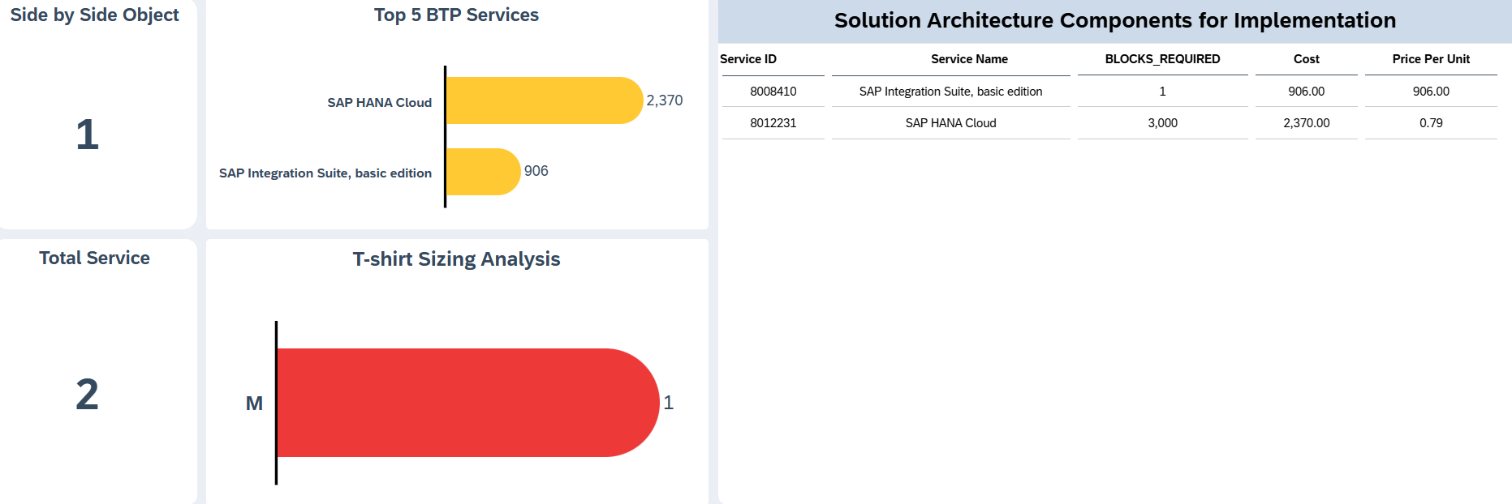
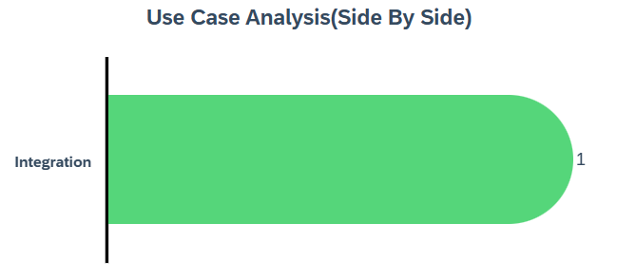
Key Insights and Recommendations | Side-By-Side
1/3 Objects is a candidate for BTP Side-by-Side Extensibility, with use case areas being Integration. Suggested BTP Services are SAP HANA Cloud and SAP IS.

Slide 13
CoreAssess.AI
Assessment
Recommendations for Retire

Slide 14
Key Insights and Recommendations | Retire
Object: zitd_cycle_count_accuracy (Cycle Count)
Recommended Approach: Candidate for Retire
Key Issues:
Custom ABAP report (zitd_cycle_count_accuracy) directly accesses tables (/SCWM/TAAREA, /LIME/PI_LOGHEAD, /LIME/PI_DCTYTXT), uses procedural ABAP, and ALV reporting. This creates upgrade challenges, technical debt, and partial misalignment with SAP’s Clean Core strategy.
Key Modernization Steps:
Retire and replace with standard Fiori App F0379A – Manage Physical Inventory Documents
Use APIs (API_WAREHOUSE_STOCK, API_INVENTORY_COUNT) instead of custom logic
Replace direct table access with CDS Views (I_StorageBin, I_PhysicalInventoryDocumentHeader, I_PhysicalInventoryDocumentTypeText)
Move to OO-ABAP for modularity and lifecycle management
Enhance reporting via embedded analytics and Fiori UI instead of ALV

Slide 15
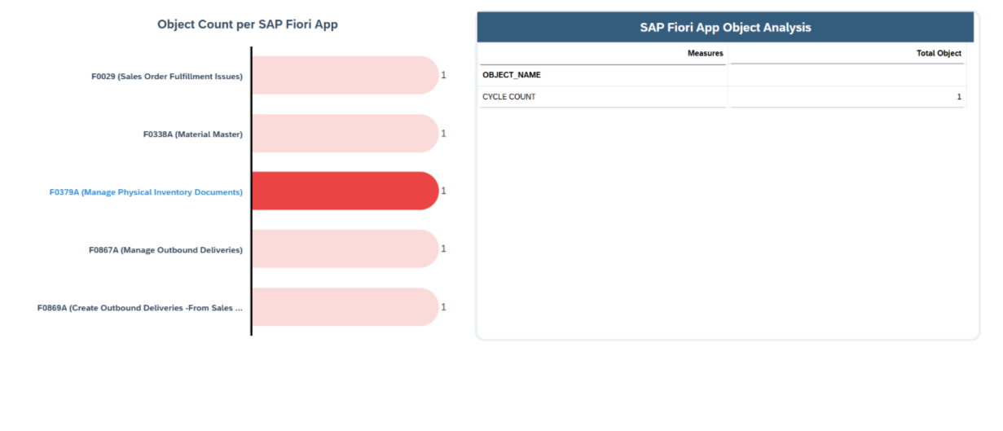
Key Insights and Recommendations | Retire
1/3 Object [zitd_cycle_count_accuracy] is a candidate for retire with suggested Fiori APP F0379A – Manage Physical Inventory Documents

Slide 16
CoreAssess.AI
Project Approach

Slide 17
3. CoreAssess.AI - Clean Core Assessment Approach
3
Architecture & Technical Analysis
Business & Functional Validation
ABAP Object Extraction
5
1
Automated or manual extraction of ABAP objects
Evaluate system architecture and object distribution
Validate findings with functional experts
6
2
Automated Assessment Execution
4
Assessment & Insights Review
Final Review & Recommendations
Share remediation plan and optimization recommendations
Run CoreAssess.AI with Crave team
Highlight critical objects, risks, and opportunities
The assessment may take between 2-4 weeks depending on the number of objects

Slide 18
CoreAssess.AI
Benefits

Slide 19


4. Benefits over Traditional Assessment
Quick Comparison between traditional clean core assessment method vs AI-powered Crave’s CoreAssess.AI
Considerations
Traditional Method
CoreAssess.AI led Approach
Automation Level
Low to Medium
High - 90%+
Analysis Scope
Limited (Technical/Code Focused)
Holistic (Functional + Technical)
Speed
Time-Intensive
70% faster Rapid (AI-Driven)
Actionable Insights
Limited
Comprehensive
Dashboard & Visualization
Minimal
Advanced
Scalability
Manual Scaling Effort
Effortless 95%+ scaling
Cost
High (Consultants, Custom Tools)
40% more Cost-effective
Strategic Alignment
Reactive
Proactive

Slide 20
CoreAssess.AI
Commercial Model

Slide 21

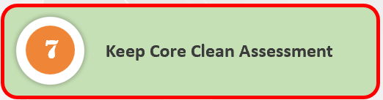
Working Together
Platinum
Gold
Scope
Silver
Assess 10000+ ABAP Objects
Share detailed technical and functional assessment
BTP services utilization estimation
Modernization effort estimate
Generate design documents
ROI calculations
Scope
Starter Pack
Scope
Assess 2500+ ABAP Objects
Share detailed technical and functional assessment
BTP services utilization estimation
Modernization effort estimate
Generate design documents
ROI calculations
Scope
Assess 50+ ABAP Objects
Share detailed technical and functional assessment
BTP services utilization estimation
Modernization effort estimate
Generate design documents
Assess 5 ABAP Objects
Share detailed technical and functional assessment
BTP services utilization estimation
Modernization effort estimate
Duration
Duration
Duration
Duration
1 weeks
1-2 weeks
2-4 weeks
4+ weeks
Price
Price
Price
Price
Complementary
$10 per Object
$7.5 per Object
$5 per Object
If the client provides a list of objects, the above pricing applies.

Slide 22
Working Together
Platinum
Gold
Scope
Silver
Assess 1000+ ABAP Program
Share detailed technical and functional assessment
BTP services utilization estimation
Modernization effort estimate
Generate design documents
ROI calculations
Scope
Starter Pack
Scope
Assess 250+ ABAP program
Share detailed technical and functional assessment
BTP services utilization estimation
Modernization effort estimate
Generate design documents
ROI calculations
Scope
Assess 5+ ABAP Program
Share detailed technical and functional assessment
BTP services utilization estimation
Modernization effort estimate
Generate design documents
Assess 5 ABAP Program
Share detailed technical and functional assessment
BTP services utilization estimation
Modernization effort estimate
Duration
Duration
Duration
Duration
1 weeks
1-2 weeks
2-4 weeks
4+ weeks
Price
Price
Price
Price
Complementary
$100 per Program
$75 per Program
$50 per Program
If the client provides a list of ABAP programs, the above pricing applies.

Slide 23






Your Success is Our Priority
Let's Win Together!
+1 844 CRAVEIT (272-8348)
contact@craveinfotech.com
www.craveinfotech.com
USA
Crave Infotech LLC, 2035 Lincoln Hwy
Suite: 3008D, Edison, NJ- 08817, USA
INDIA
Software Technology Parks of India, P-1, Unit 2-A, Rajiv Gandhi InfoTech park, MIDC, Hinjewadi Phase-1, Pune, (MH)411057

